Slide 1
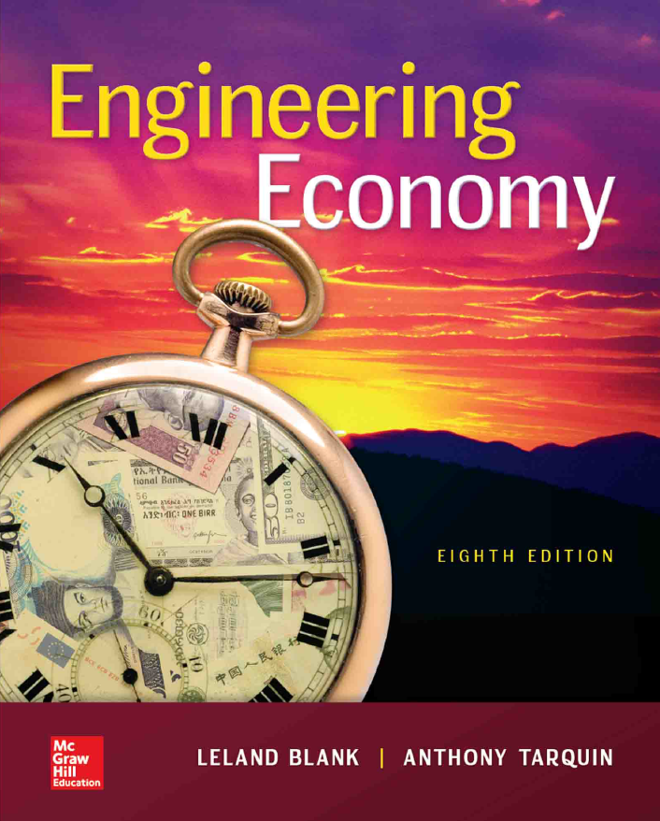

Chapter 16
Depreciation Methods
Lecture slides to accompany
Engineering Economy
8th edition
Leland Blank
Anthony Tarquin

Slide 2
LEARNING OUTCOMES
Understand basic terms of asset depreciation
Apply straight line method of depreciation
Apply DB and DDB methods of depreciation
Apply MACRS method of depreciation
Select asset recovery period for MACRS
Explain depletion and apply cost depletion & percentage depletion methods
16-<number>

Slide 3


Depreciation Terminology
Definition: Book (noncash) method to represent decrease in value of
a tangible asset over time
Two types: book depreciation and tax depreciation
Book depreciation: used for internal accounting to track value of assets
Tax depreciation: used to determine taxes due based on tax laws
In USA only, tax depreciation must be calculated using MACRS;
book depreciation can be calculated using any method
16-<number>

Slide 4
Depreciation Terminology
Assets | Liabilities & Owner’s Equity
Cash $21,000 Accounts Receivable $10,000 Tools $35,000 Total $66,000 | Invested Capital $50,000 Retained Earning $16,000 Total $66,000
Assets | Liabilities & Owner’s Equity
Cash $21,000 Accounts Receivable $10,000 Tools(Tangible Asset) $28,000 ($35,000 - $7,000) Total $59,000 | Invested Capital $50,000 Retained Earning $9,000 ($16,000 - $7,000) Total $59,000
16-<number>

Slide 5
Concept
Assume A Co. purchase $1M machine that has 5 years of life with SL(or DB) depreciation.
- Actual Cash Flows
0
1
2
3
4
5
$1M
- Accounting Depreciation Cost (SL)
0
1
2
3
4
5
$0.2M
$0.2M
$0.2M
$0.2M
$0.2M
OR
- Accounting Depreciation Cost (DB)
$0.07M
$0.09M
0
1
2
3
4
5
$0.14M
16-<number>
$0.25M
$0.45M

Slide 6
Concept (Discussed later)
Assume A Co. purchase $1M machine that has 5 years of life with SL depreciation. Assuming NOPAT is $0.1M, compare Accounting analyses and Actual cash flows with i=10%.
- Accounting Depreciation Cost (SL)
$0.1M
$0.1M
$0.1M
$0.1M
$0.1M
0
1
2
3
4
5
NPV=0.1(P/A,10%, 5)=$0.38M
- Actual Cash Flows
$0.3M
$0.3M
$0.3M
$0.3M
$0.3M
0
1
2
3
4
5
NPV=0.3(P/A,10%, 5) - 1= $0.14M
$1M
16-<number>

Slide 7
Common Depreciation Terms
First cost P or unadjusted basis B: Total installed cost of asset
Book value BV_{t}: Remaining undepreciated capital investment in year t
Recovery period n: Depreciable life of asset in years
Market value MV: Amount realizable if asset were sold on open market
Salvage value S: Estimated trade-in or MV at end of asset’s useful life
Depreciation rate d_{t}: Fraction of first cost or basis removed each year t
Personal property: Possessions of company used to conduct business
Real property: Real estate and all improvements (land is not depreciable)
Half-year convention: Assumes assets are placed in service in midyear
16-<number>

Slide 8
Straight Line Depreciation
Book value decreases linearly with time
B - S
D_{t} =
Where: D_{t} = annual depreciation charge
t = year
B = first cost or unadjusted basis
S = salvage value
n = recovery period
n
BV_{t} = B - tD_{t}
Where: BV_{t} = book value after t years
SL depreciation rate is constant for each year: d = d_{t} = 1/n
16-<number>

Slide 9
Example: SL Depreciation
An argon gas processor has a first cost of $20,000 with a
$5,000 salvage value after 5 years. Find (a) D₃ and (b) BV₃
for year three. (c) Plot book value vs. time.
Solution: (a ) D₃ = (B – S)/n
= (20,000 – 5,000)/5
= $3,000
(c) Plot BV vs. time
BV_{t}
20,000
(b) BV₃ = B – tD_{t}
= 20,000 – 3(3,000)
= $11,000
11,000
5,000
0
3
5
Year, t
16-<number>

Slide 10
Declining Balance (DB) and
Double Declining Balance (DDB) Depreciation
Determined by multiplying BV at beginning of year by fixed percentage d
Max rate for d is twice straight line rate, i.e., d ≤ 2/n
Cannot depreciate below salvage value
BV₀ = B
BV₁ = BV₀ - BV₀·d = B(1 – d)
BV₂ = BV₁ – BV₁·d = B(1 – d)²
:
BV_{t} = BV_{t-1} – BV_{t-1}·d = B(1 – d)^{t}
Book value for year t is given by:
BV_{t} = B(1 – d)^{t}
Depreciation for year t is obtained by either relation:
D_{t} = dBV_{t-1} = dB(1 – d)^{t-1}
Where: D_{t} = depreciation for year t
d = uniform depreciation rate (2/n for DDB)
B = first cost or unadjusted basis
BV_{t -1} = book value at end of previous year
16-<number>

Slide 11
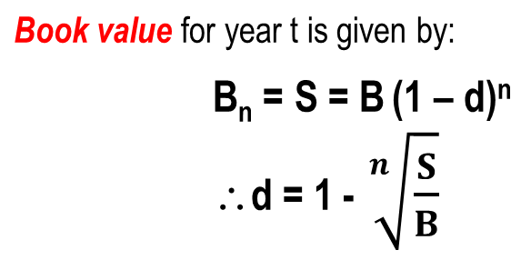
Declining Balance (DB) Depreciation
Determined by multiplying B at beginning of year by fixed percentage d
where Max. d = 2/n
Where: B_{n} = Book value for year n
d = uniform depreciation rate
B = first cost or unadjusted basis

Slide 12

Example: Double Declining Balance
A depreciable construction truck has a first cost of $20,000 with a
$4,000 salvage value after 5 years. Find the (a) depreciation, and
(b) book value after 3 years using DDB depreciation.
Solution: (a) d = 2/n = 2/5 = 0.4
D₃ = dB(1 – d)^{t-1}
= 0.4(20,000)(1 – 0.40)³⁻¹
= $2880
(b) BV₃ = B(1 – d)^{t}
= 20,000(1 – 0.4)³
= $4320
16-<number>

Slide 13



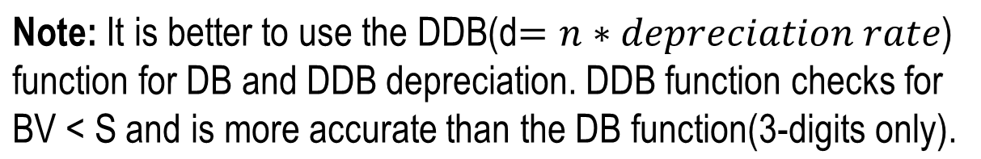
Spreadsheet Functions for Depreciation
Straight line function: SLN(B,S,n)
Declining balance function: DB(B,S,n,t)
Double declining balance function: DDB(B,S,n,t,d)
16-<number>

Slide 14
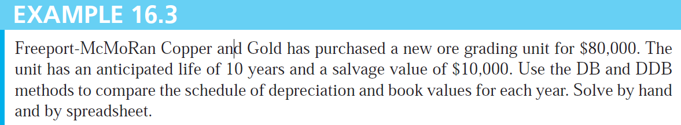
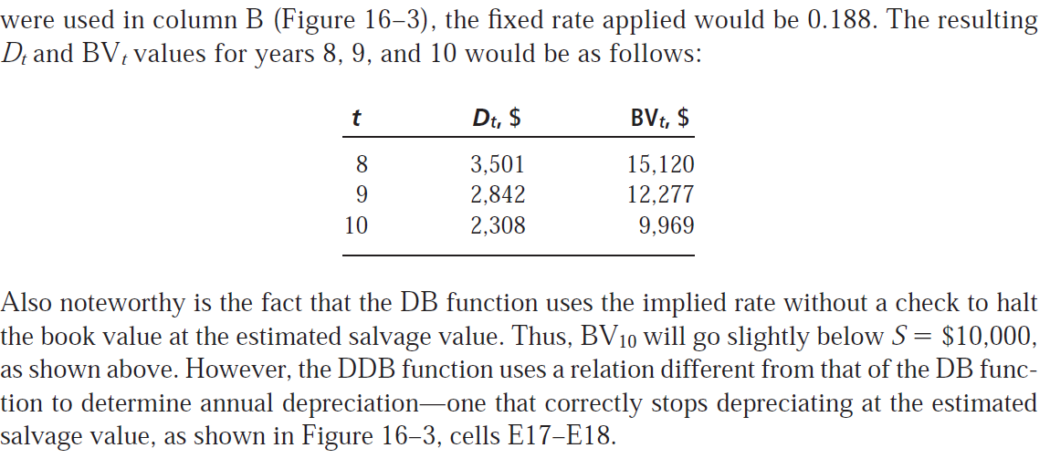
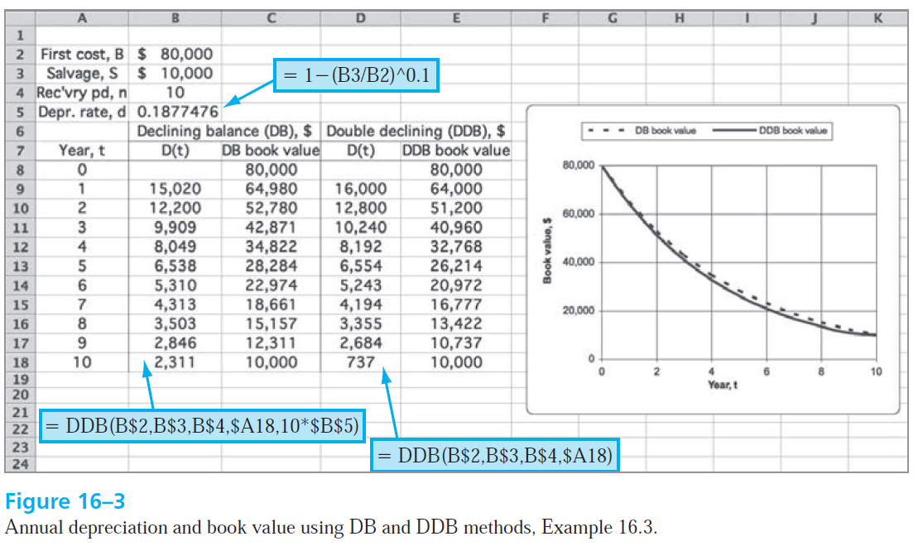
16-<number>

Slide 15
MACRS Depreciation
Required method to use for tax depreciation in USA only
Originally developed to offer accelerated depreciation for economic growth
Where: D_{t} = depreciation charge for year t
B = first cost or unadjusted basis
d_{t} = depreciation rate for year t (decimal)
D_{t} = d_{t}B
Get value for d_{t} from IRS table for MACRS rates
j = t
BV_{t} = B - ∑D_{j}
Where: D_{j} = depreciation in year j
∑ D_{j} = all depreciation through year t
j = 1
16-<number>

Slide 16
MACRS Depreciation
Always depreciates to zero; no salvage value considered
Incorporates switching from DDB to SL depreciation
Standardized recovery periods (n) are tabulated
MACRS recovery time is always n+1 years;
half-year convention assumes purchase in midyear
No special spreadsheet function; can arrange VDB
function to display MACRS depreciation each year
16-<number>

Slide 17

Example: MACRS Depreciation
A finishing machine has a first cost of $20,000 with a $5,000
salvage value after 5 years. Using MACRS, find (a) D and (b) BV
for year 3.
Solution:
(a) From table, d₃ = 19.20
D₃ = 20,000(0.1920)
= $3,840
(b) BV₃ = 20,000 - 20,000(0.20 + 0.32 + 0.1920)
= $5,760
Note: Salvage value S = $5,000 is not used by MACRS and BV₆ = 0
16-<number>

Slide 18
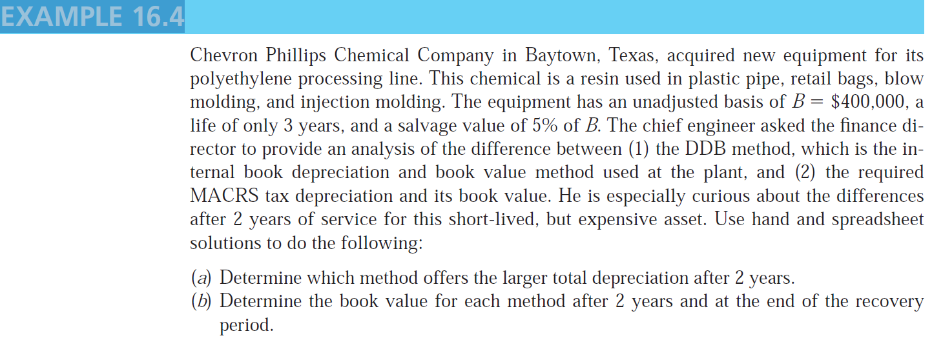
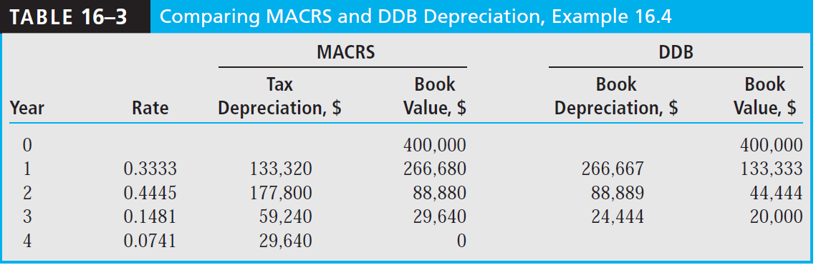
16-<number>

Slide 19
MACRS Recovery Period
Recovery period (n) is function of property class
Two systems for determining recovery period:
general depreciation system (GDS) – fastest write-off allowed
alternative depreciation system (ADS) – longer recovery; uses SL
IRS publication 946 gives n values for an asset. For example:
MACRS n value
Asset description GDS ADS range
Special manufacturing devices, racehorses, tractors 3 3 - 5
Computers, oil drilling equipment, autos, trucks, buses 5 6 - 9.5
Office furniture, railroad car, property not in another class 7 10 – 15
Nonresidential real property (not land itself) 39 40
16-<number>

Slide 20
Depletion Methods
Depletion: book (noncash) method to represent decreasing value of natural resources
Two methods: cost depletion (CD) and percentage depletion (PD)
Cost depletion: Based on level of activity to remove a natural resource
Calculation: Multiply factor CD_{t} by amount of resource removed
Where: CD_{t} = first cost / resource capacity
Total depletion can not exceed first cost of the resource
Percentage depletion: Based on gross income (GI) from resource
Calculation: Multiply GI by standardized rate (%) from table
Annual depletion can not exceed 50% of company’s taxable income (TI)
16-<number>

Slide 21

Example: Cost and Percentage Depletion
A mine purchased for $3.5 million has a total expected yield of one million ounces of silver. Determine the depletion charge in year 4 when 300,000 ounces are mined and sold for $30 per ounce using (a) cost depletion, and (b) percentage depletion. (c) Which is larger for year 4?
Solution: Let depletion amounts equal CDA₄ and PDA₄
(a) Factor, CD₄ = 3,500,000/ 1,000,000 = $3.50 per ounce
CDA₄ = 3.50(300,000) = $1,050,000
(b) Percentage depletion rate for silver mines is 0.15
PDA₄ = (0.15)(300,000)(30) = $1,350,000
(c) Claim percentage depletion amount, provided it is ≤ 50% of TI
16-<number>

Slide 22
Summary of Important Points
Two types for depreciation: tax and book
Classical methods are straight line and declining balance
In USA only, MACRS method is required for tax depreciation
Determine MACRS recovery period using either GDS or ADS
Switching between methods is allowed; MACRS switches
automatically from DDB to SL to maximize write-off
Depletion (instead of depreciation) used for natural resources
Two methods of depletion: cost (amount resource removed × CD_{t} factor) and percentage (gross income × tabulated %)
16-<number>

Slide 23
HOMEWORK
Please solve every Examples in your textbook. You do not have to submit your works.
No Exercise Homework.
4-<number>

